Slide 1

Terry Bogard
The Legendary Wolf

Slide 2
Who are we?
Tomas Marquez
Brennen Cruz

Slide 3

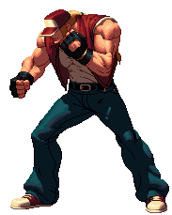
Who is Terry?

Slide 4
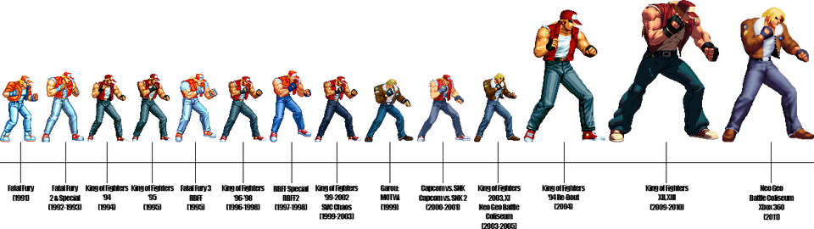
Terry Through the Ages

Slide 5

Cultural Impacts

